Slide 1
AWS EC2 Assignments
Assignment 1:
Launch an EC2 instance using the AWS Management Console.
Install and configure Apache or NGINX on the instance.
Verify the web server is accessible from your browser using the instance's public IP address.
Submit a report with the steps, screenshots, and the public IP address.

Slide 2
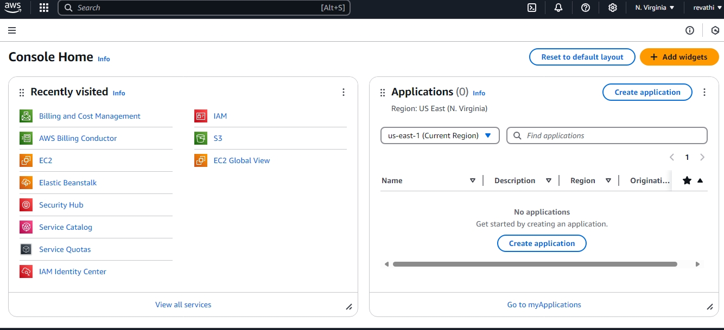
STEP-1 Sign in to the AWS account
STEP-2 Coming to the AWS console home STEP -3 open the ec2

Slide 3
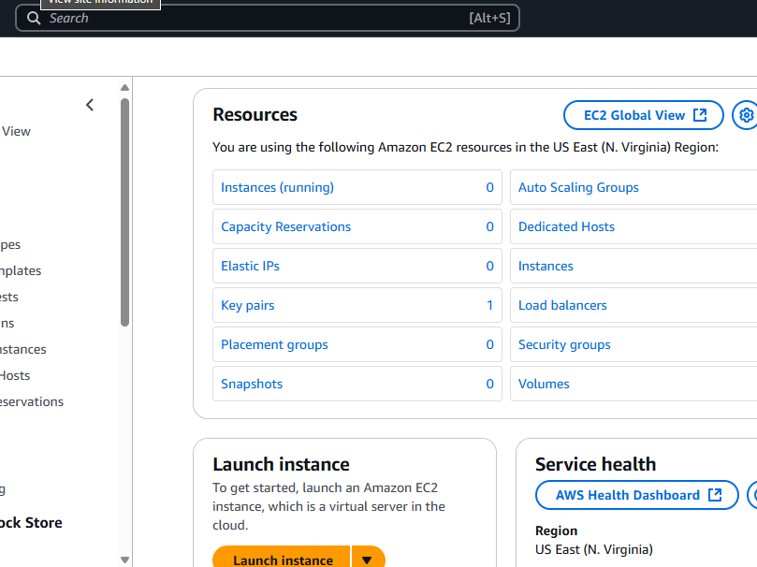
Step-4 launch the instance

Slide 4
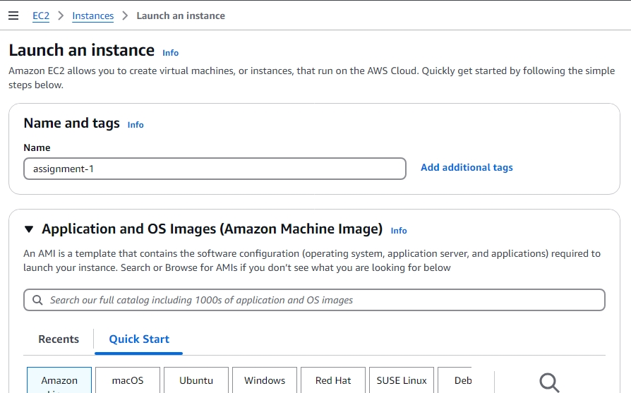
STEP-5 give the name and select AMI

Slide 5
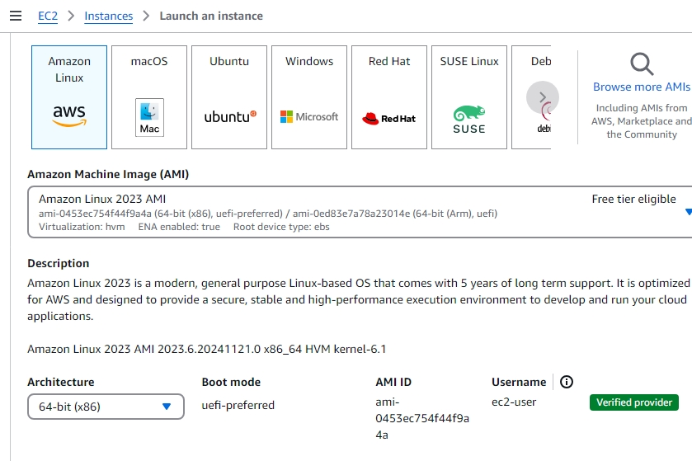
STEP-6 selected AMI on Amazon Linux in free trier

Slide 6
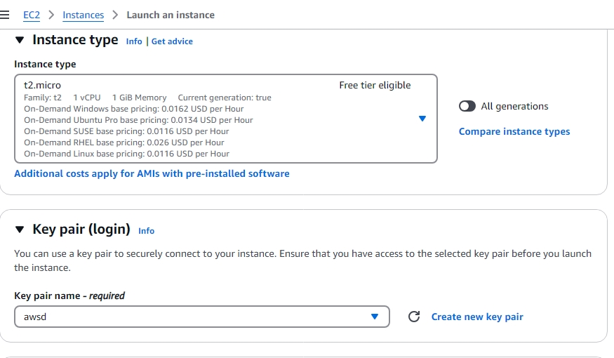
STEP-7 select the instance I selected t2 micro in free trier
STEP-8 create a key pair and given the key pair login

Slide 7
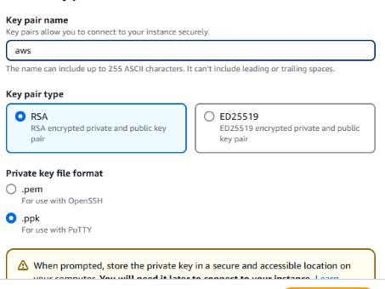
STEP-9 create new key pair and given the key pair login.

Slide 8
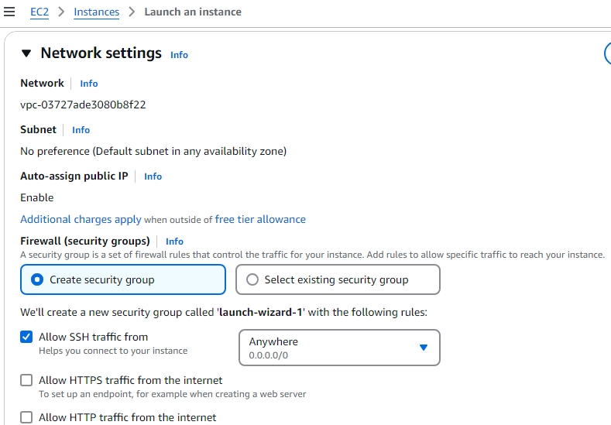
STEP-10 edit the network setting
STEP-11 select the default VPC
STEP-12 auto assign public ip is enable
STEP-13 select create security group and allow SSH traffic from

Slide 9
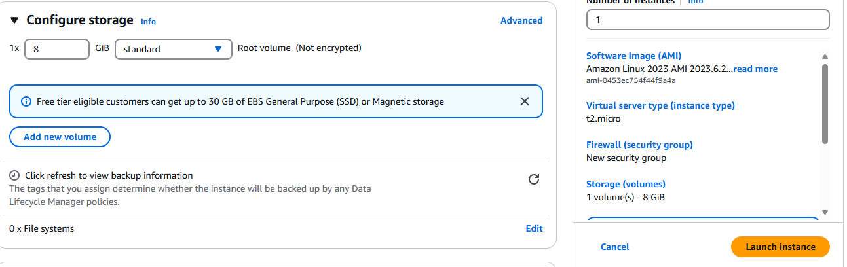
STEP-14 select the configure storage
STEP-15 when complete the configure storage launch the instance

Slide 10
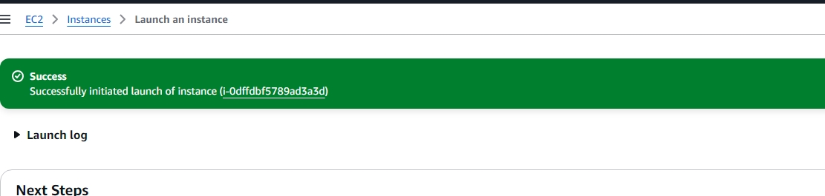
STEP-16 successfully launch instance

Slide 11
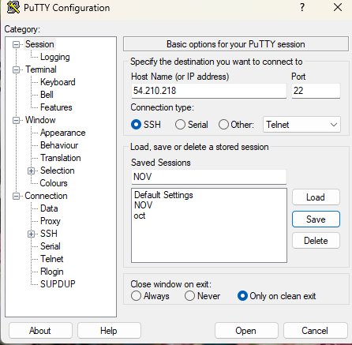
STEP-17 connect the AWS ec2 instance in putty
Step-18 Given the host name in ec2 instance ip

Slide 12
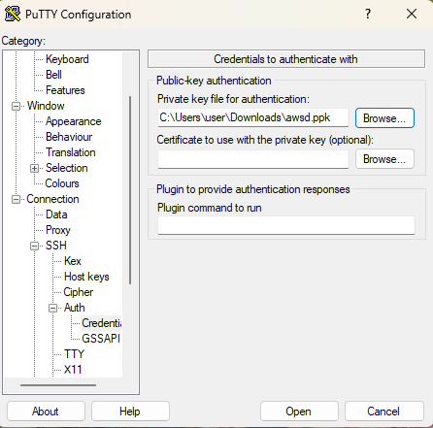
STEP-19 select the SSH and Auth and credential
STEP-20 to select credential give the private . When we create a key pair in ec2 instance.

Slide 13
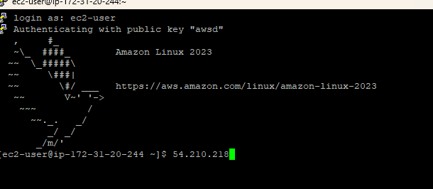
STEP-21 login to the putty

Slide 14
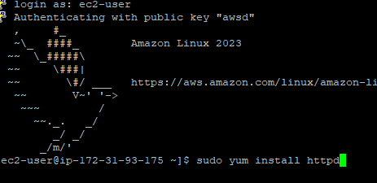
STEP-22 Install the apache using this command

Slide 15


C
STEP-23 complete the apache install
STEP-24 enable the httpd
Step-25 launching a default html file
STEP-26 inserting the content to html
STEP-27 I – insert mode, write content save it :wq
STEP-28 launching the apache server

Slide 16
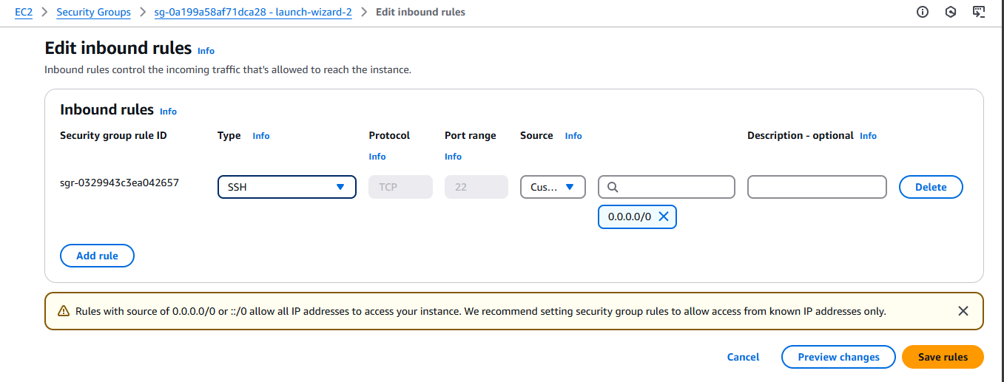
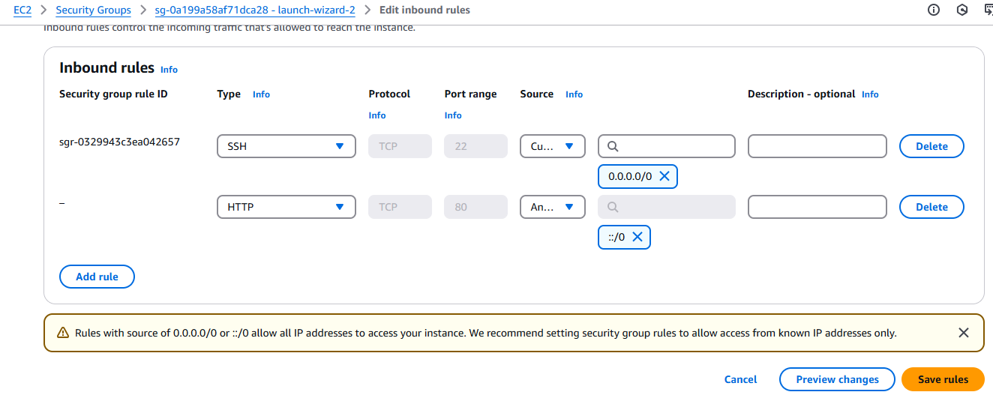
STEP-29 Edit the security inbound rule because we have SSH rule there we want HTTP rule.
STEP-30 Adding the http and port range 80 ads source any were.

Slide 17
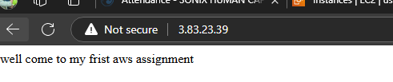
STEP-31 copy the ec2 instance public ip and past new web server page. we get result
SUCCESSFULLY I AM ACCESSING

